Slide 1
Accounting
Student Workflow

Slide 2
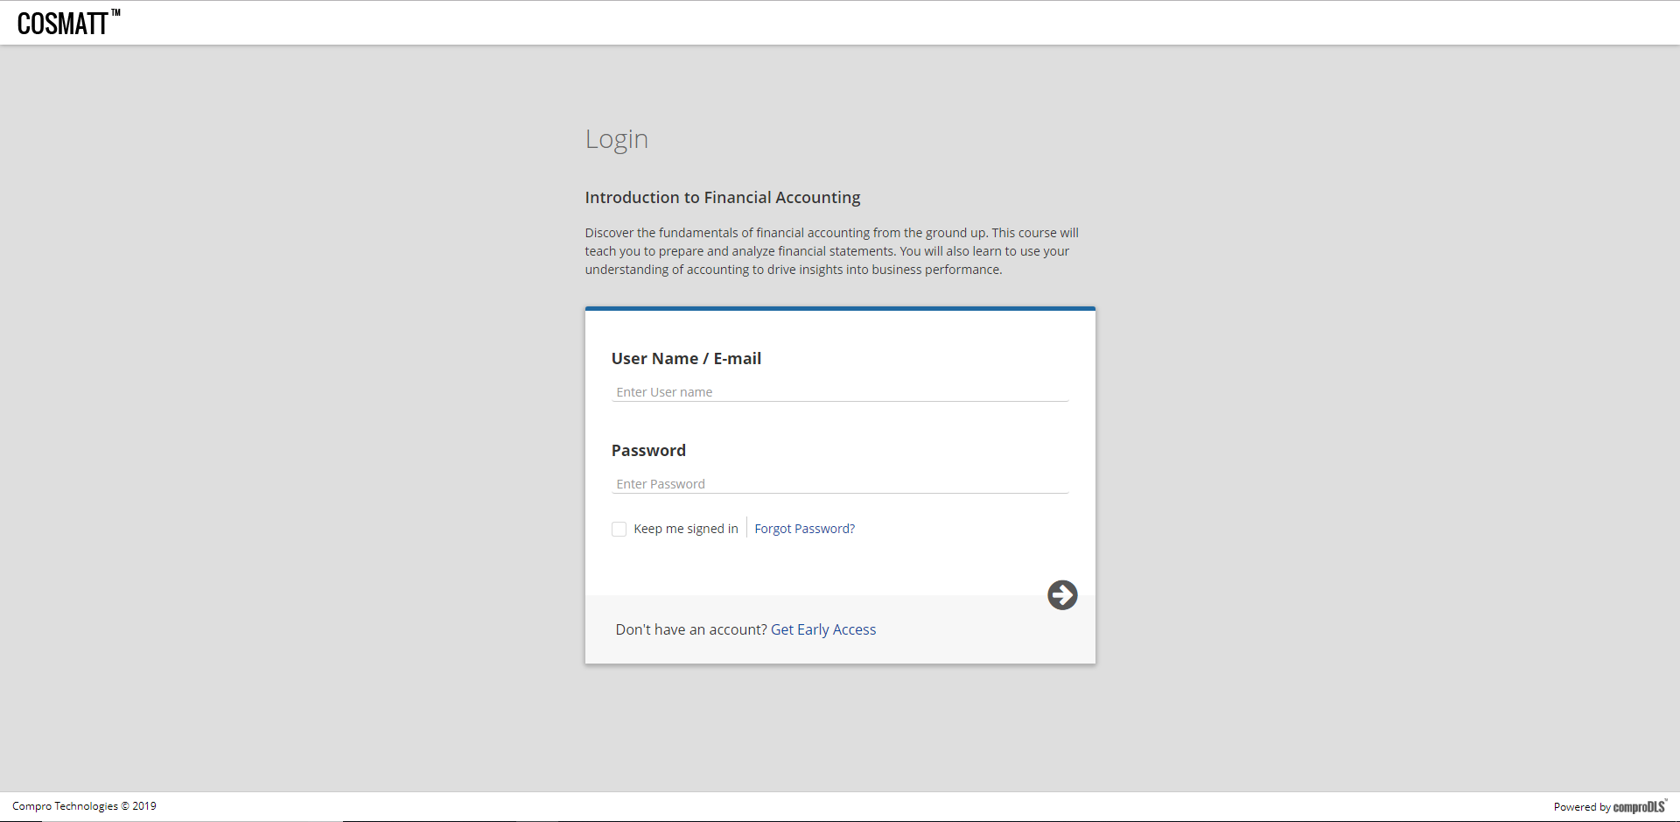
Login Page

Slide 3
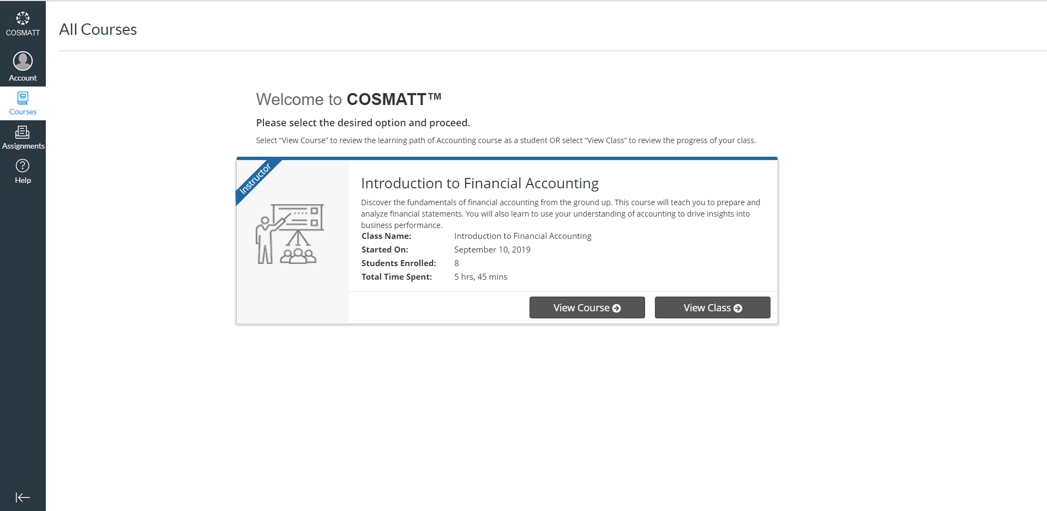
Student’s Home Page

Slide 4
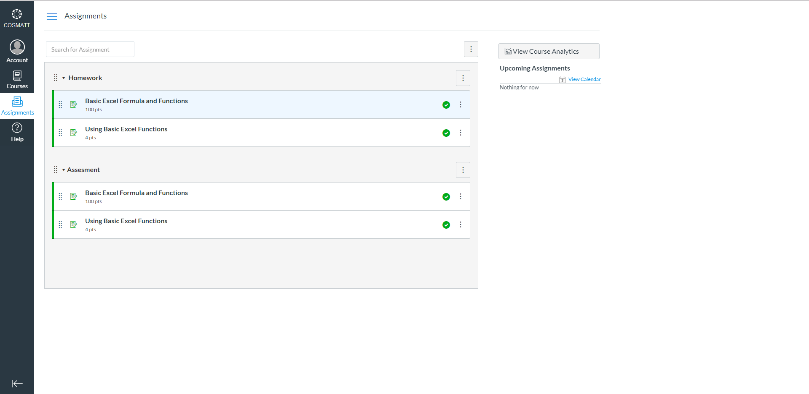
Assignments List Page

